Slide 1



Sentiment Analysis For Instagram
By: Sudha R

Slide 2

Overview
Introduction
Data Overview
Data preprocessing
Sentiment Analysis Approach
Sentiment Distribution
Key Insights
Recommendation
Conclusion

Slide 3
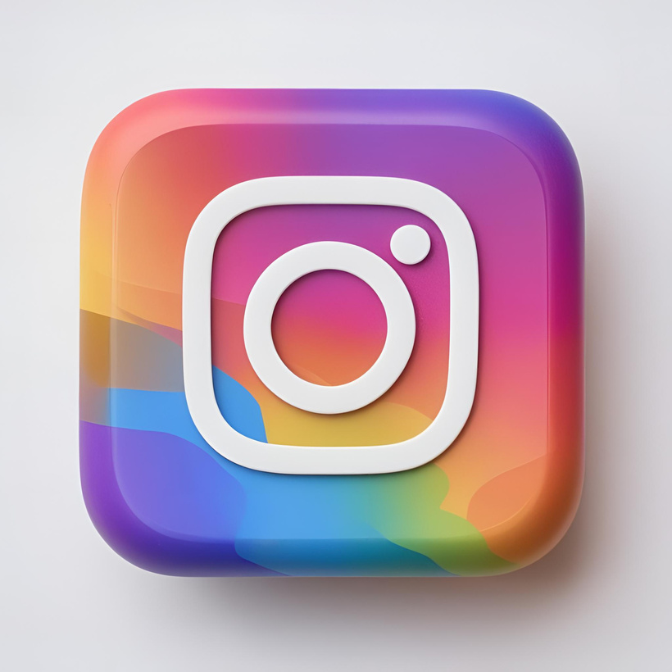
Introduction
This report presents an analysis of Instagram comments to understand public sentiment towards specific topics, products, and events. The study utilizes Natural Language Processing (NLP) techniques to preprocess text data, extract sentiment scores, and visualize sentiment trends over time.

Slide 4
Data Overview
Dataset Source: Instagram comments dataset
Total Records: 2000
Columns
Comment Id
Username
Comment
Timestamp
Likes
Sentiment
Total Comments
Total Shares
Post Type
Topic

Slide 5
Data Preprocessing
Converted text to lowercase and removed special characters.
Tokenized text and removed stopwords.
Applied Named Entity Recognition (NER) to extract entities.
Converted timestamp into date and month format for trend analysis.

Slide 6
Sentiment Analysis Approach
Concept In Business
Sentiment Classification
Used VADER (Valence Aware Dictionary and Sentiment Reasoner) to categorize comments into Positive, Negative, and Neutral sentiments.
Polarity & Subjectivity
Extracted polarity (positive/negative scale) and subjectivity (opinion-based content) using TextBlob.
Word Cloud
Generated word clouds to visualize frequently used words per sentiment category.

Slide 7
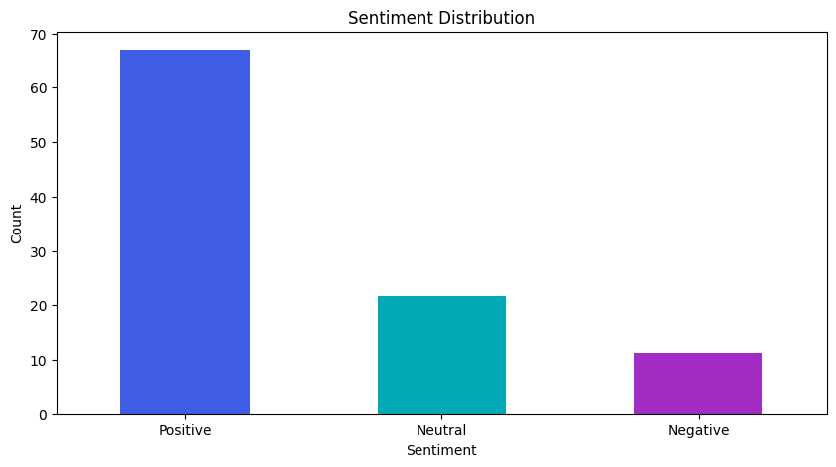
Sentiment Distribution
Overall Sentiment

Slide 8
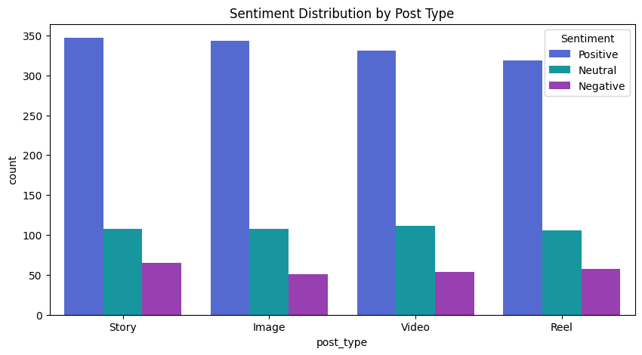
Sentiment Distribution
By Post

Slide 9
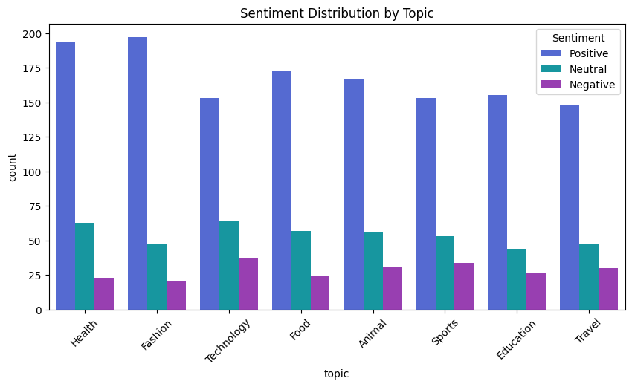
Sentiment Distribution
By Topic

Slide 10
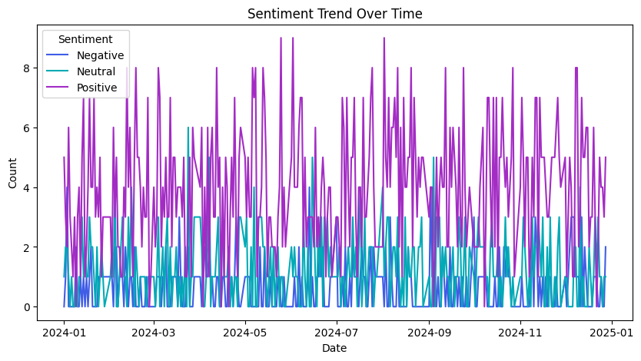
Sentiment Trend Over Time

Slide 11
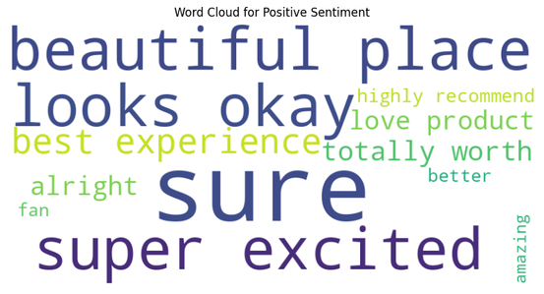
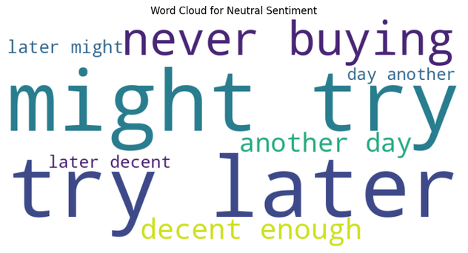
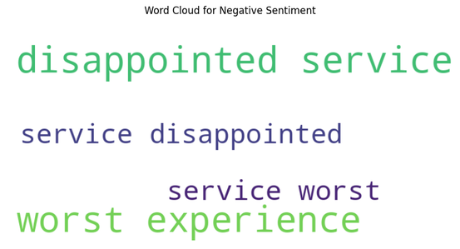
Word Clouds For Sentiment
Positive
Neutral
Negative

Slide 12
Key Insights & Recommendations
Content Strategy
Focus more on reels and videos, as they generate higher positive sentiment.
Engage with users on weekends for maximum positive response.
Crisis Management
Monitor sentiment spikes for negative comments and address issues promptly.
Use named entity analysis to track brand perception.
Marketing & Brand Awareness
Leverage influencer collaborations to enhance positive sentiment.
Target food and fashion content for higher audience engagement.
CEO & Founder

Slide 13
Conclusion
This analysis provides valuable insights into audience sentiment on Instagram, helping brands and content creators optimize engagement strategies. Future studies can incorporate deep learning models for more precise sentiment classification.

Slide 14

THANK YOU!

